Slide 1
Reduce Flood Risk
a library of flood mitigation strategies and resources

Slide 3
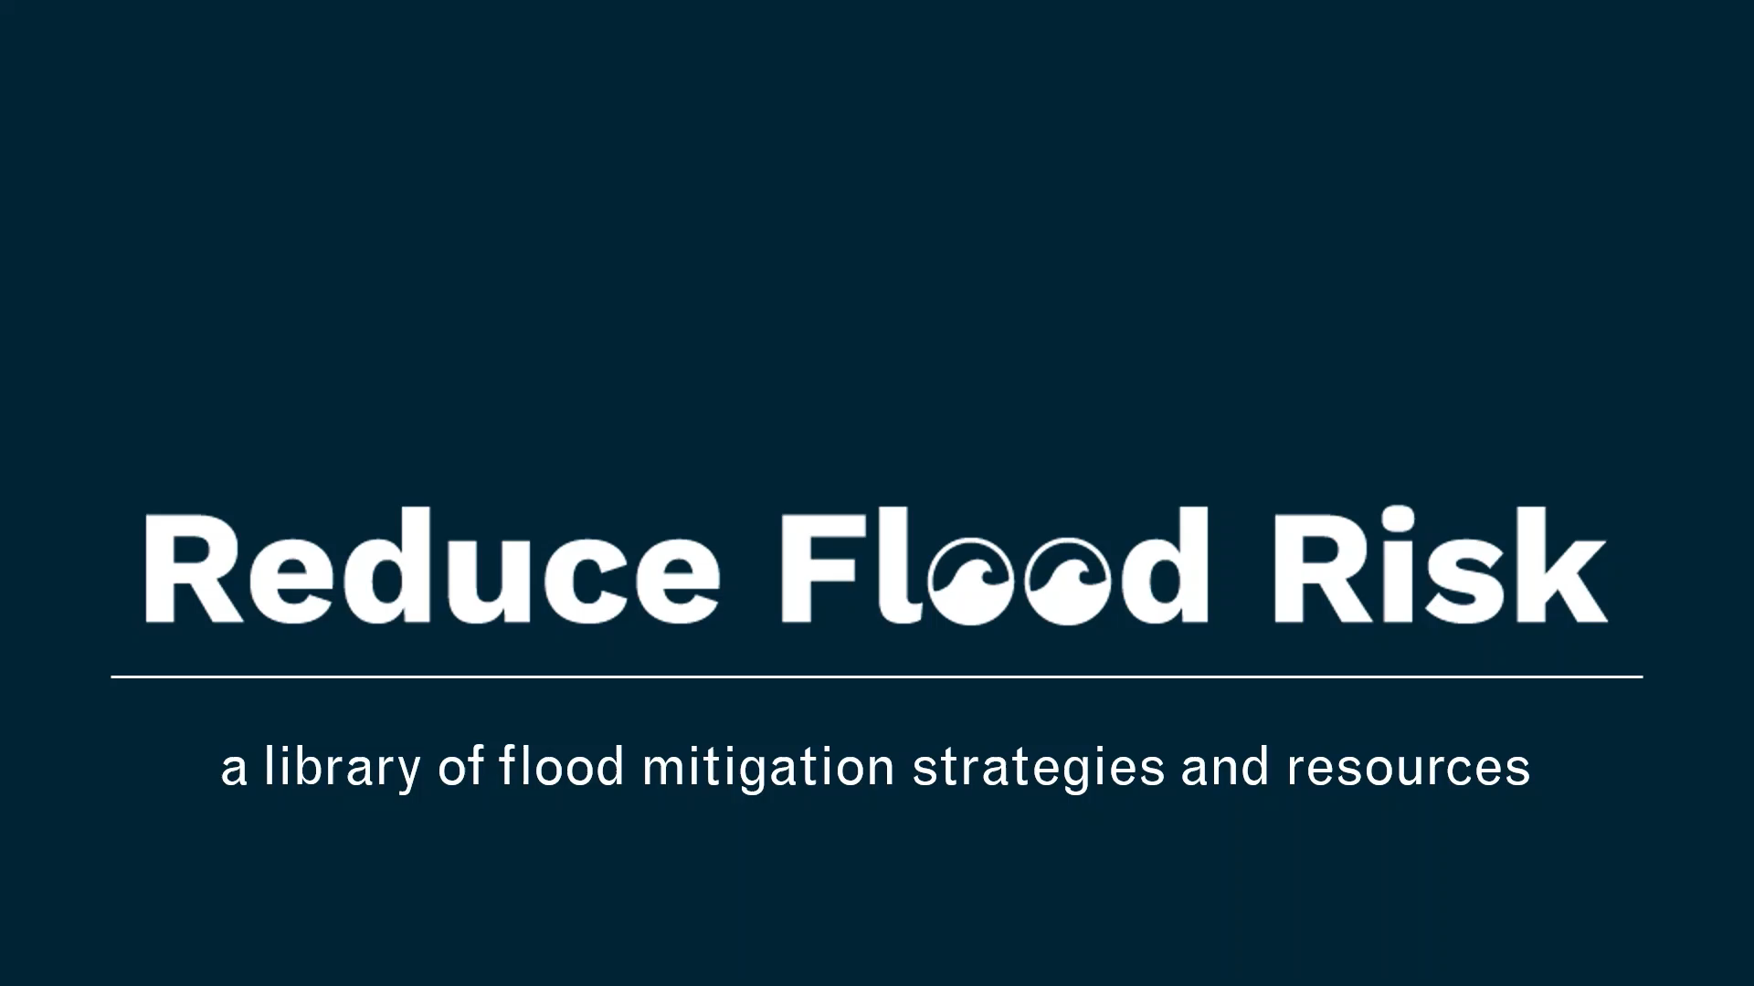

Slide 4
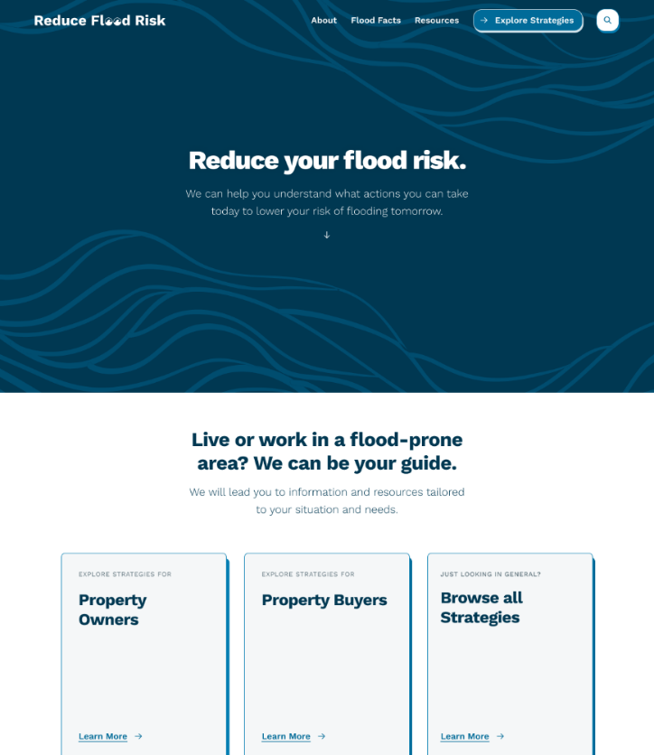
Objectives
To help property owners and buyers in flood-prone areas identify strategies to reduce their property's risk of flooding.
To connect anyone looking to reduce their flood risk with mitigation information and resources.

Slide 5
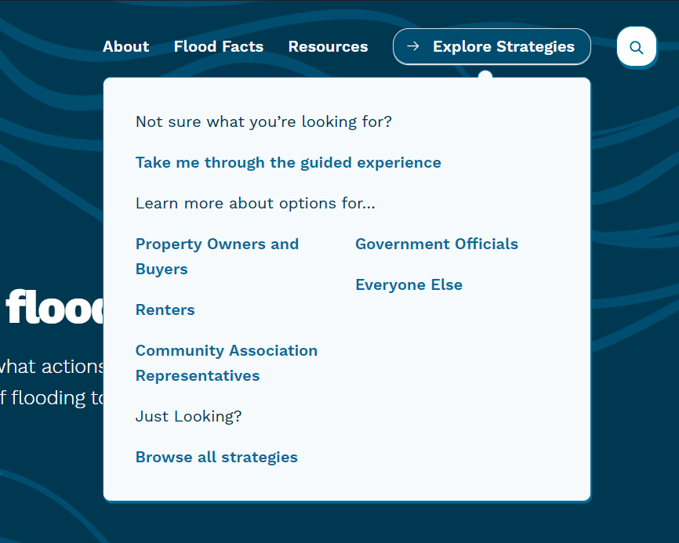
How ReduceFloodRisk.org Can Help You
Provides an introduction to floodplains, flooding, flood hazards, and flood risk
Guides your search for flood risk reduction strategies that can work for your specific property
Connects you to additional flood mitigation resources
Answers your questions

Slide 6
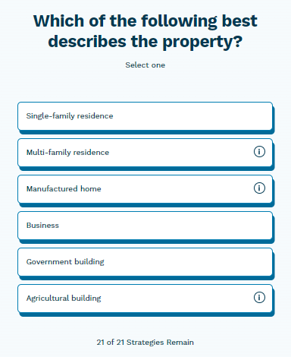
Guided Search
Asks you to answer 5 simple questions:
How do you identify? Are you a property owner or buyer?
Which of the following best describes the property?
What type of foundation does the structure have?
Is the property located in a coastal high hazard area?
To your knowledge, has the property flooded before?
    How deep was the water during past floods?
    Is the property in the potential path of a debris flow or ice flow?

Slide 7
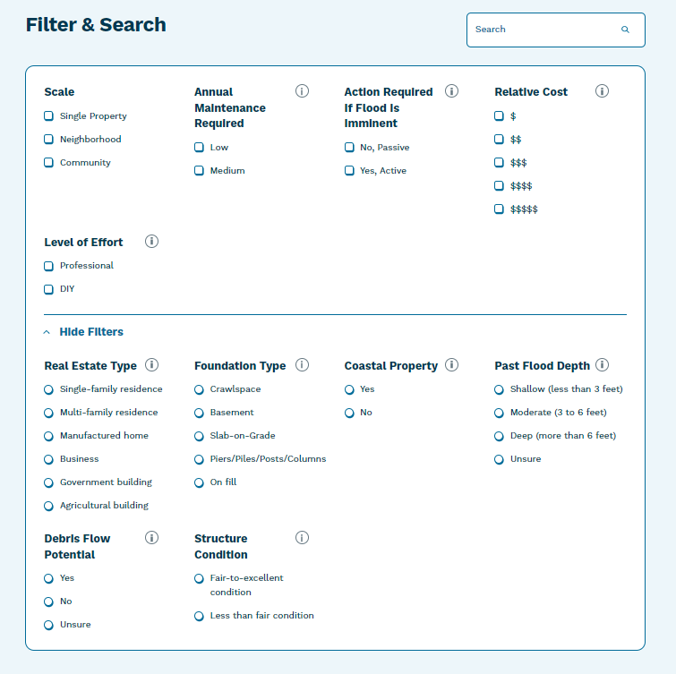
Filters
Two types of filters:
Those associated with the guided search that will help the system give you the best search results for your specific property.
Those to help decide which mitigation option you might want to implement or explore further

Slide 8

Visit ReduceFloodRisk.org

