Slide 1
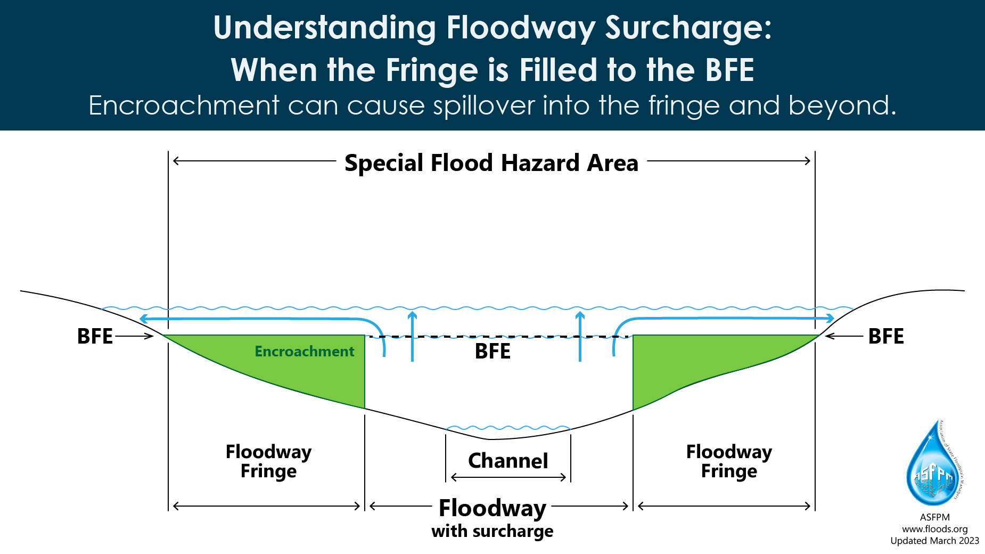
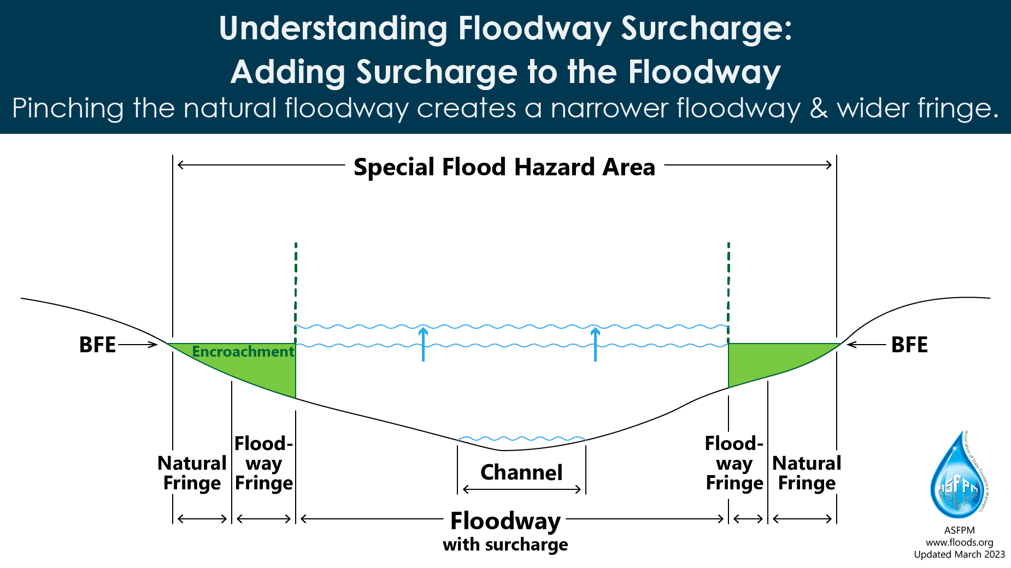
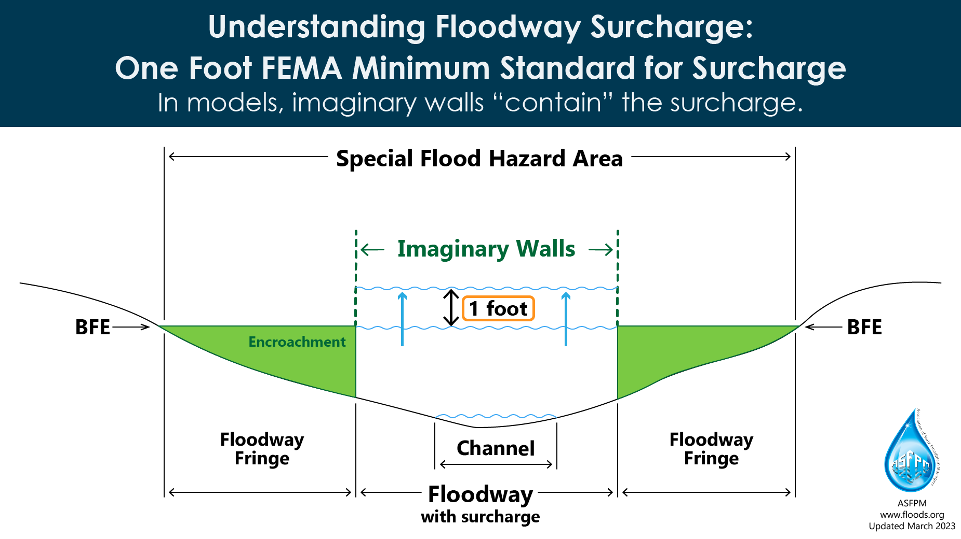
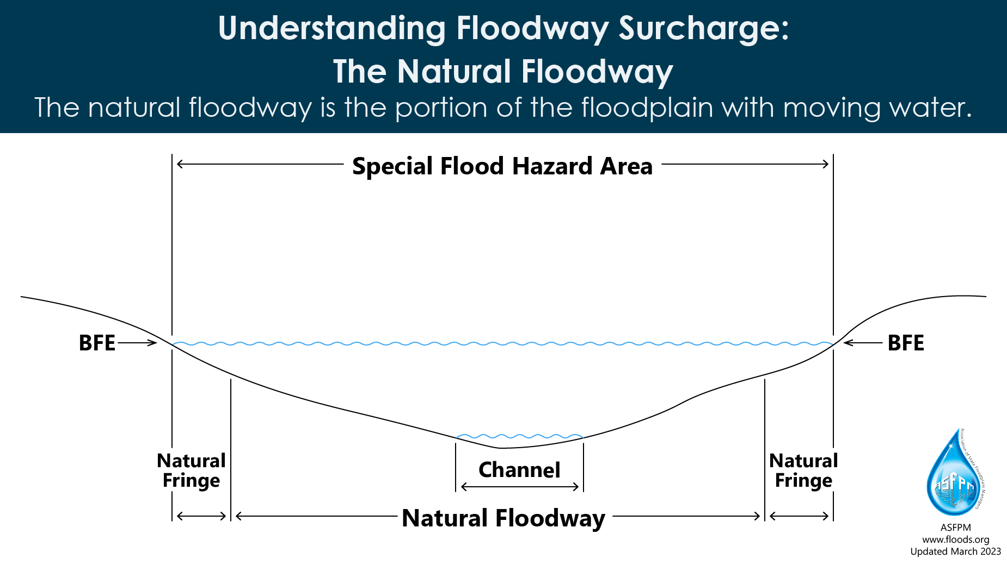

Slide 2
Notes:
The Natural Floodway is the portion of the floodplain with moving water. Backwater areas without moving water are the natural fringe. It is assumed that if the natural fringe is filled there is no increase because there is no blockage of moving water. This however ignores the impact of loss of flood storage.

Slide 3
Notes:
For a floodway with a surcharge the natural floodway is pinched in until the surcharge amount is reached. This creates a narrower floodway and wider fringe.

Slide 4
Notes:
The FEMA minimum standard for surcharge is one foot. The FEMA Encroached Floodway caused the floodwaters to rise by one foot.

Slide 5
Notes:
This graphic highlights that when the fringe is filled to the BFE, the increased flooding that is caused by this encroachment flows up and out of the floodway into the fringe and actually out beyond the mapped Special Flood Hazard Area.

